Slide 1
Airbnb Predictor
Colt Korth Danielle Fulgenzi
Erin Neubauer John Compton

Slide 2
Overview
Project Description/Outline:
Users will be able to enter in their potentially new rental space and receive a competitive price to list at.
Users can view/filter the overall Nashville listings for Nashville TN
Dataset:
The dataset(s) contains Airbnb information pulled from "Host" users in the Nashville TN area. The original dataset is divided in 4 fiscal quarters (Q4'21, Q1'22, Q2'22, Q3'22).

Slide 3
Tools Used
Cleaning - Pandas
Database - SQL and Postgres
Machine Learning - Sklearn
App/Webpage - Plotly / Tableau / Flask-HTML

Slide 4
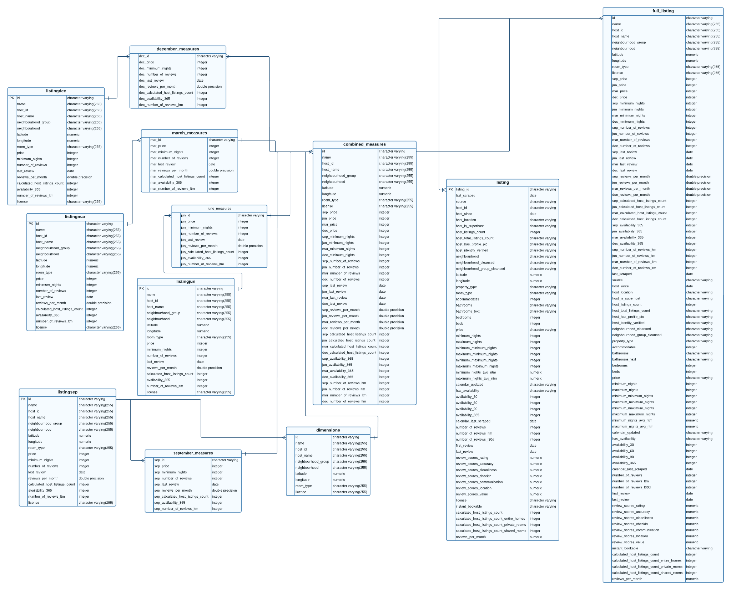
Database Overview

Slide 5
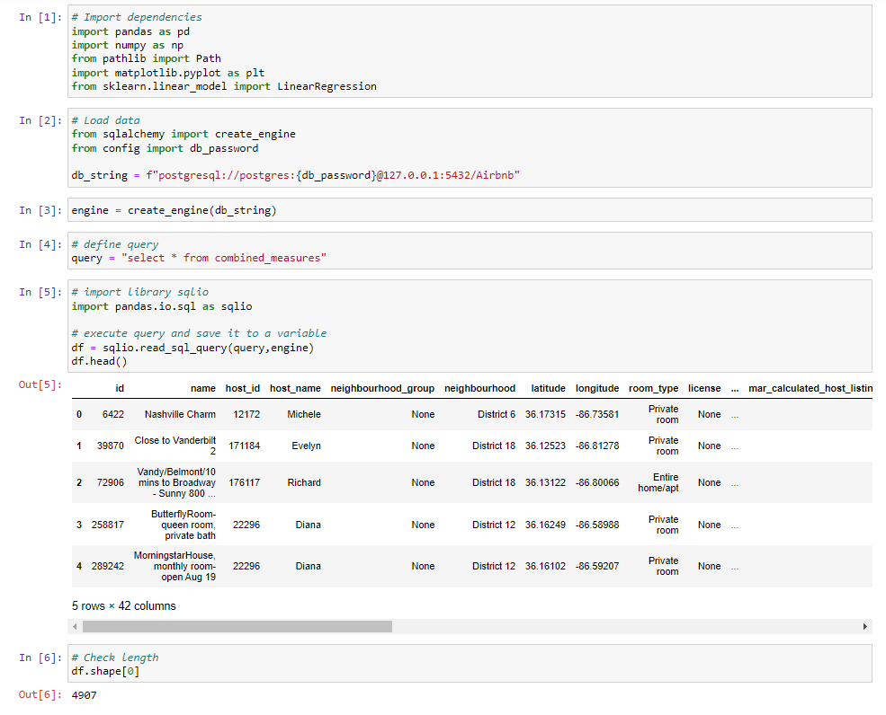
Machine Learning Model
Currently using a linear regression because our target feature (Airbnb price) is a continuous variable.
Preprocessing has involved the following:
Deleting listings without reviews in the current year.
Drop columns unnecessary for machine learning model:
Host_id
Latitude
Longitude
Drop major outlier (listing with a price over $9k/night).
Drop null values.

Slide 6
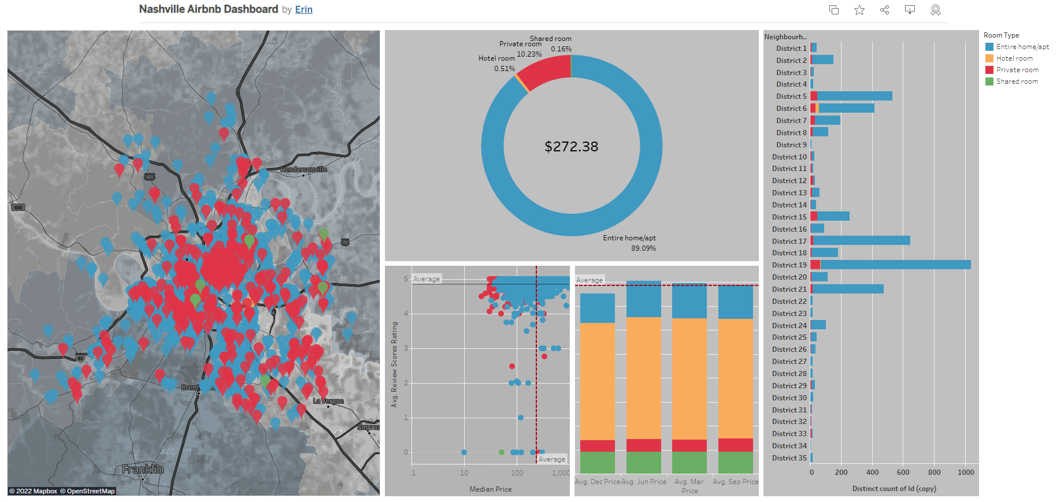
Main Page Dynamic Graph
Graph shows information over the map of Nashville as defined by the filters applied.
Filters:
Neighborhood
Rental size
Number of bedrooms
Price
[Chart image goes here]

Slide 7
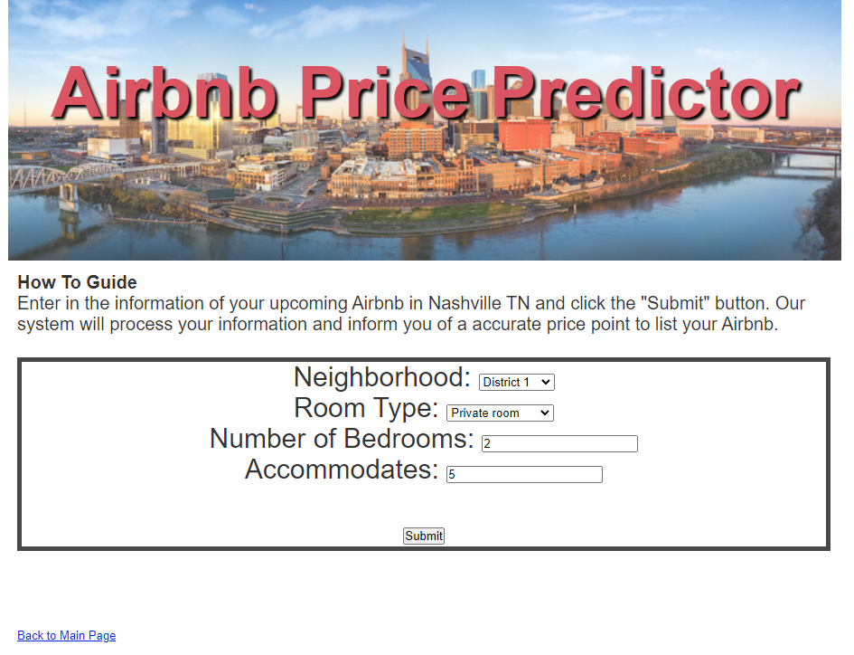
Price Predictor (Input)
Users will input data on their upcoming Airbnb. Once they click “submit” our program will compare the user inputs to our data and predict an accurate starting price point for the user.

Slide 8
Price Predictor (Output)
[Screenshot goes here]
Users will be directed to this page after the machine learning algorithm runs and predicts a price based on the inputs they entered.

Slide 9
The End

